Slide 1

RAG Based ChatBot
Project by :
Group no.5
guided by:
Prof.Veena Sarda

Slide 2
Problem Statement
To design a chatbot that accurately answers user queries by retrieving relevant information from documents and generating responses strictly based on that retrieved context, while avoiding hallucinations.

Slide 3
What is RAG?
Retrieval Augmented Generation (RAG) is an advanced NLP technique that combines information retrieval with text generation.
It retrieves relevant information from external sources (documents, PDFs, databases) before generating answers.
Unlike traditional language models, RAG does not rely only on pre-trained knowledge.
Two main stages in RAG:
  Retrieval Stage – Fetches relevant document chunks using semantic similarity search.
  Generation Stage – An LLM generates responses using the retrieved context.
Grounding answers in retrieved data reduces hallucinations.
Ensures responses are accurate, contextual, and document-based.
Commonly used in document Q&A systems, chatbots, knowledge assistants, and educational applications.

Slide 4
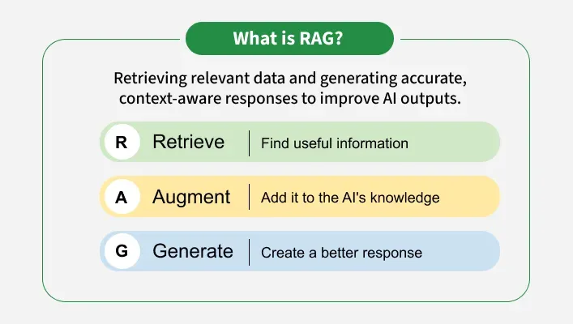

Slide 5
Need Of RAG Model
1. LLMs Do Not Know Your Private Data
2. Reduces Hallucinations
3. No Need to Retrain the Model
4. Handles Frequently Changing Data
5. Improves Answer Accuracy
6. Domain-Specific Question Answering
7. Explainable Responses

Slide 6
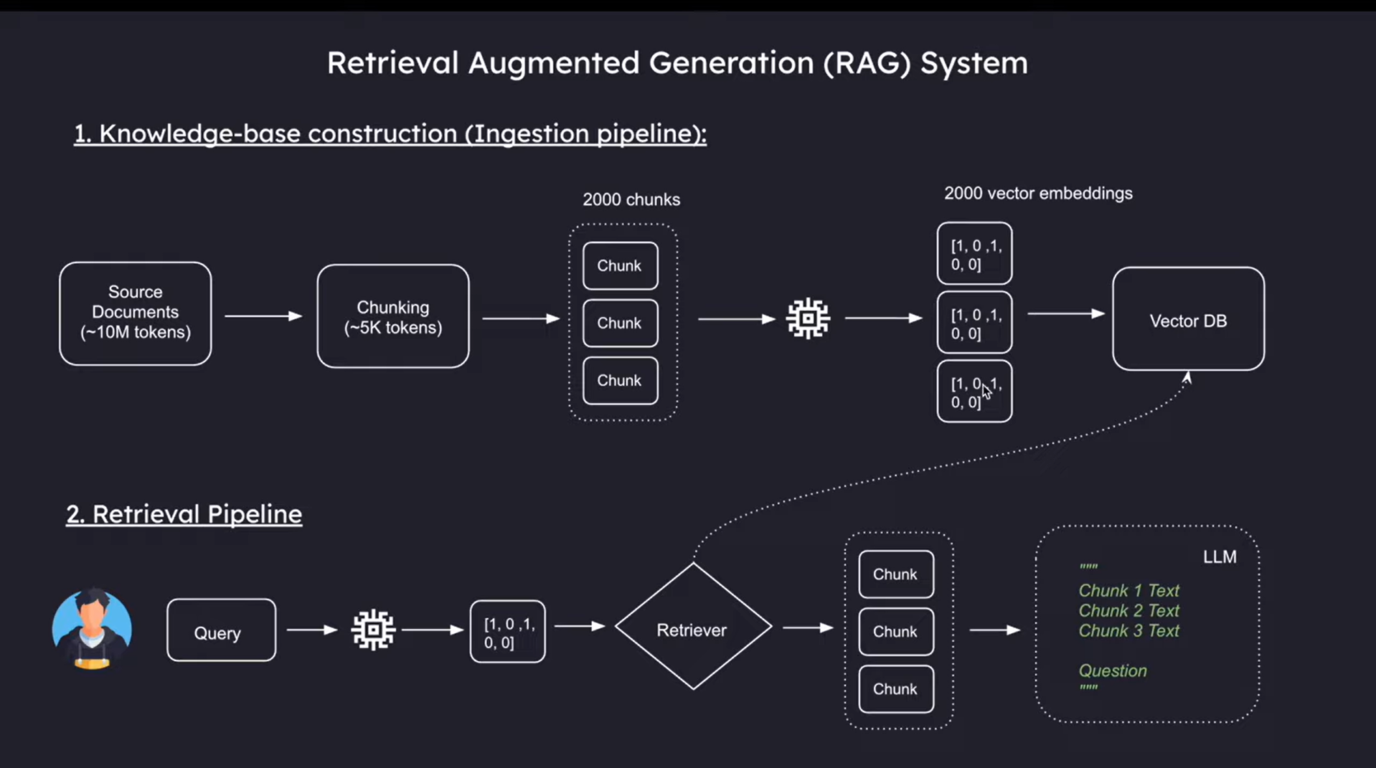
RAG Architecture

Slide 7
Tokenization
Tokenization converts raw text into tokens such as words,subwords,or characters.
We have used RecursiveCharacterTextSplitter
RecursiveCharacterTextSplitter is a LangChain utility used to split large text into smaller chunks in a smart and hierarchical way, so that LLMs can process the text efficiently.
Maintains paragraph & sentence structure
Produces context-aware chunks
Improves retrieval accuracy in vector DBs
Keeps overlap so meaning is not lost

Slide 8
Sentence BERT
SBERT creates sentence-level embeddings that can be directly compared using cosine similarity.
Sentence-BERT is a modified version of BERT
It converts sentences or paragraphs into fixed-length vector embeddings
These embeddings capture semantic meaning of the sentence
BERT gives word-level embeddings, not sentence-level
Comparing sentences using BERT is slow and inefficient
SBERT enables fast and accurate sentence similarity

Slide 9
Vector DB
A database optimized to store and search high-dimensional vectors efficiently.
Vectors represent the semantic meaning of data (text, images, audio)
Enables similarity search using mathematical distance measures
Why Vector Databases are Needed?
Traditional databases are poor at semantic search
Vector DBs find meaningfully similar data, not just exact matches
Essential for AI, NLP, and LLM-based applications
Examples : FAISS, Chroma, Pinecone

Slide 10
Frameworks / Libraries Used
1. Python
Primary programming language used for backend development
Provides flexibility and rich AI/ML ecosystem
2. LangChain
Framework used to build the Retrieval Augmented Generation (RAG) pipeline
Handles document loading, text splitting, prompt management, and LLM interaction

Slide 11
3. FAISS (Facebook AI Similarity Search)
Vector database used for fast similarity search
Stores document embeddings and retrieves relevant chunks efficiently
4. Sentence Transformers
Used to generate dense vector embeddings for documents and user queries
Captures semantic meaning of text
5. Ollama
Used to run Large Language Models locally (e.g., Mistral)
Enables offline inference and data privacy

Slide 12
6. Streamlit
Web framework used to create an interactive user interface
Allows users to input questions and view answers easily
7. PyPDF / PDF Loader
Used to read and extract text from PDF documents
Converts PDF content into processable text format
8. NumPy
Used for numerical operations and vector handling
Supports efficient embedding storage and manipulation
9. OS & Pickle (Python Utilities)
os: Used for file handling and directory management
pickle: Used for caching embeddings and improving performance

Slide 13
RAG Use Cases
1. Reduces Hallucination
2. Document-Based Accuracy
3. Source Transparency
4. No Need to Retrain LLM
5. Scalable and Efficient
6. Domain Adaptability

Slide 14
Limitations of RAG
1. Depends on Retrieval Quality
2. Context Window Limitation
3. Embedding Cost and Storage
4. Latency
5. Not Fully Reasoning-Based

Slide 15
Future Scope
1. Multi-Document & Multi-Modal Retrieval
2. Improved Retrieval Accuracy
3. Long-Context LLM Integration
4. Real-Time Knowledge Updates
5. Personalized and Adaptive RAG
6. Enterprise-Level Deployment

Slide 16
Conclusion
• The RAG-based chatbot successfully retrieves relevant document chunks and generates responses strictly grounded in retrieved context.
• Integration of RecursiveCharacterTextSplitter and SBERT embeddings ensures high-quality, semantically meaningful retrieval.
• Use of FAISS vector database enables fast and scalable similarity search for large document collections.
• The system reduces hallucinations, improves answer accuracy, and avoids the need for frequent model retraining.
• Overall, the project demonstrates an efficient, explainable, and domain-adaptable solution for document-based intelligent question answering.

